Slide 1


Slide 2
Introduction to Web design and cyber security
Presented by Western cyber security

Slide 3
How we Started
We started off as a group of students that enjoyed participating in CTFs.
We grew into a club that deals with all sorts of cyber security topics.
Bitcoins
Encryption
Ethical Hacking
And of course, CTFs

Slide 4
What are CTFs?
Two types: Jeopardy or Attack-Defence
Jeopardy: will have many tasks in fields such as Web, Forensic, Crypto, Binary
Attack-Defence: protect your own server while finding exploits in others

Slide 5
Example Question:
Crypto:
My favorite number is 13!
Can you decode my message?
guvf vf na rknzcyr bs n pnrfne pvcure
Hint: http://planetcalc.com/1434/
Misc:
I his the flag in this image! (flag is in flag{} format)
postimg.org/image/gttxn3f03

Slide 6
Introduction
Purpose of this workshop
Introduction to Web and HTTP
Understand and know basic structure of web development.
HTML (Structure)
CSS (Presentation)
Bootstrap (Framework)
Create a personal website/portfolio
Git, Heroku, Name Cheap, bootstrap theme

Slide 7
Preparation
Requires to install/register in following
Git Hub/ Git – register required
PhpStorm (or similar IDE) – JetBrains account required.
Heroku – register required
Name Cheap – register required

Slide 8

To get started, we will first learn Git
What is Git?
Git is a Version Control software
Simple way to upload your files to the internet
Useful for collaborations on a project
Download Git:
git-scm.com
Notes:
So, Git is a “version control system,” what’s that mean? When developers are creating something (an application, for example), they are making constant changes to the code and releasing new versions, up to and after the first official (non-beta) release.
Version control systems keep these revisions straight, and store the modifications in a central repository. This allows developers to easily collaborate, as they can download a new version of the software, make changes, and upload the newest revision. Every developer can see these new changes, download them, and contribute.
Similarly, people who have nothing to do with the development of a project can still download the files and use them. Most Linux users should be familiar with this process, as using Git, Subversion, or some other similar method is pretty common for downloading needed files, especially in preparation for compiling a program from source code (a rather common practice for Linux geeks).

Slide 9
More about git
Version control
Git projects are called a Repository (Repo)
Development can be reverted to a previous state
Since it allowing merging, multiple people can work at once on the same codebase

Slide 10
Github
GitHub is a code hosting platform for version control and collaboration. It lets you and others work together on projects from anywhere.
Create a github account for free:
Github.com

Slide 11
Create your project
Go back to Github.com
In the upper right corner, next to your avatar, click and then select New repository.
Name your repository hello-world.
Write a short description.
Select Initialize this repository with a README.

Slide 12
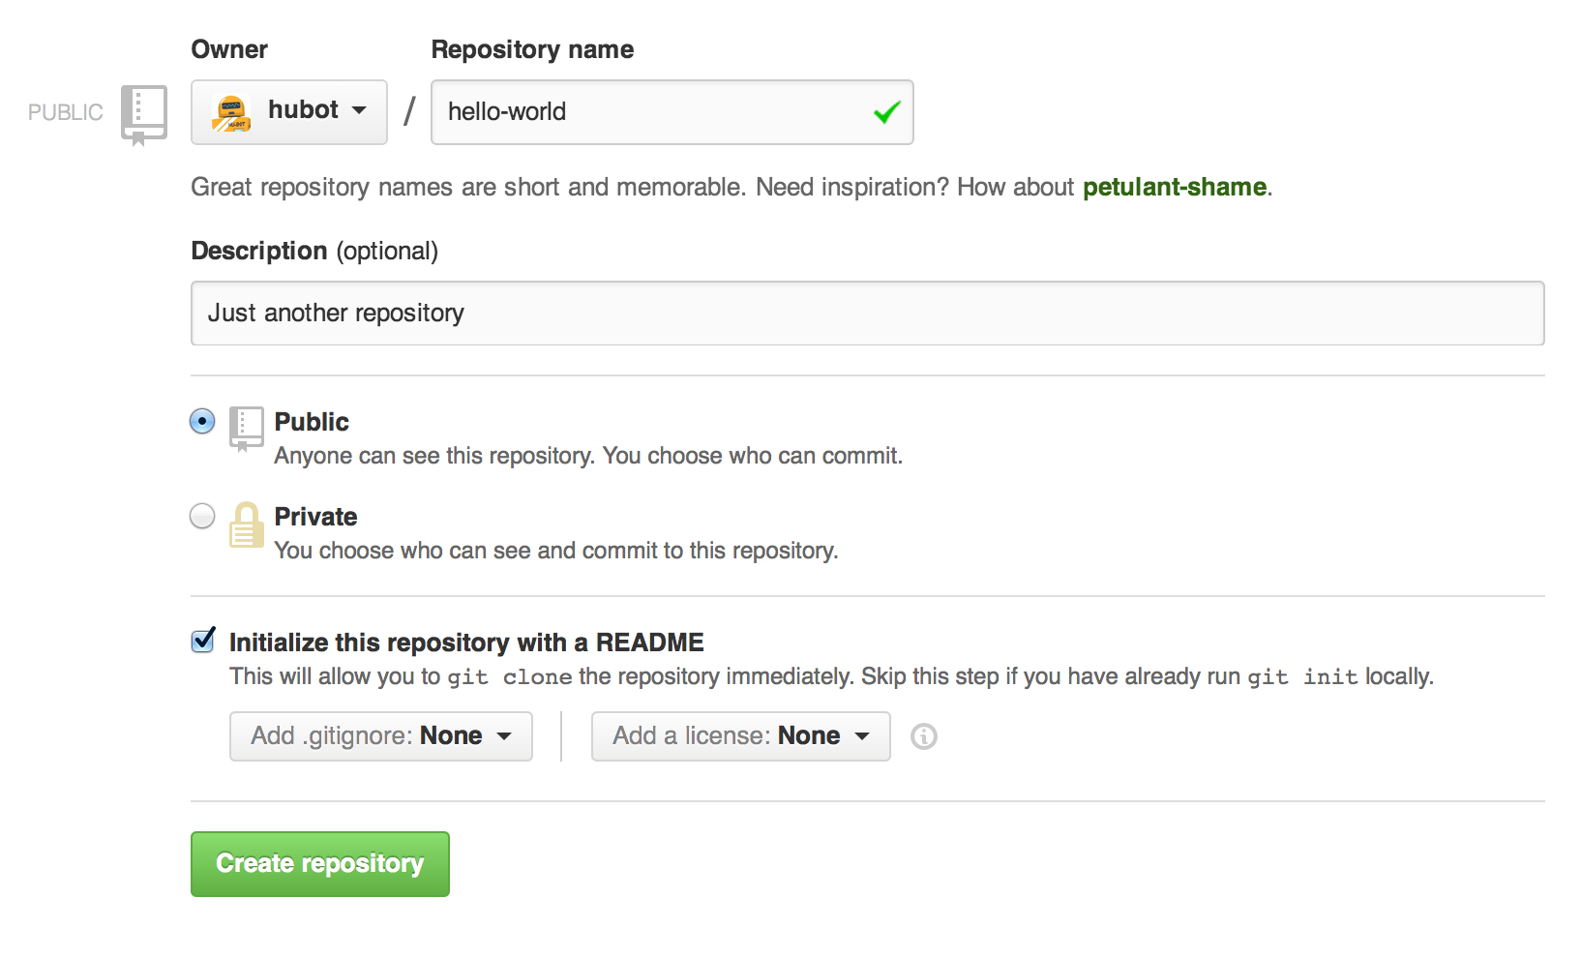

Slide 13
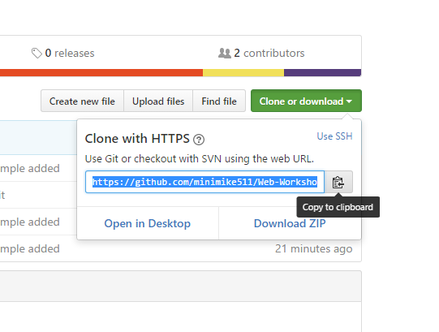
Download the project to your computer
On GitHub, navigate to the main page of the repository.
Under your repository name, click Clone or download.
Copy the link provided

Slide 14
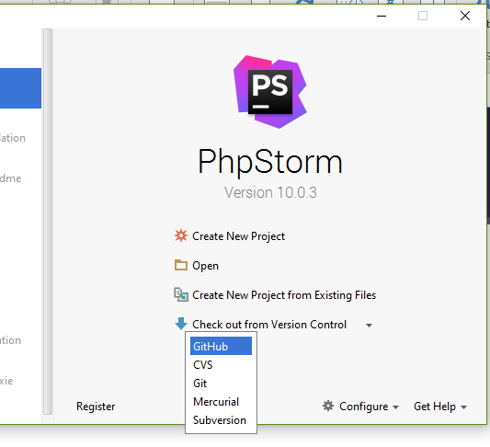
Open PhpStorm
In PhpStorm, click on the bottom option, “Check out from Version Control”
Click on GitHub

Slide 15
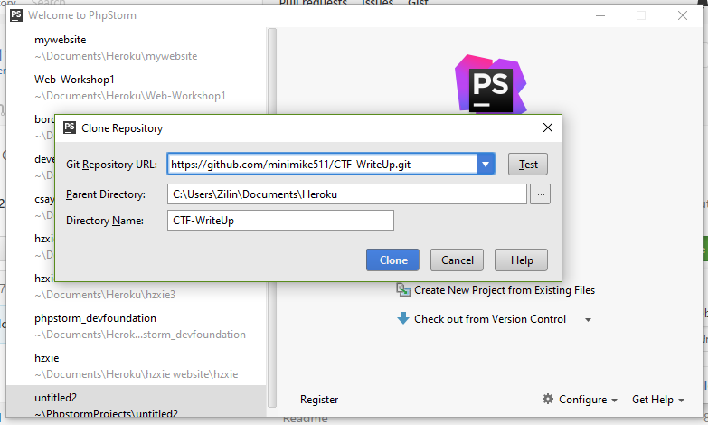
Download the Repo
Paste the git repo url into the first form
Choose the target download location

Slide 16
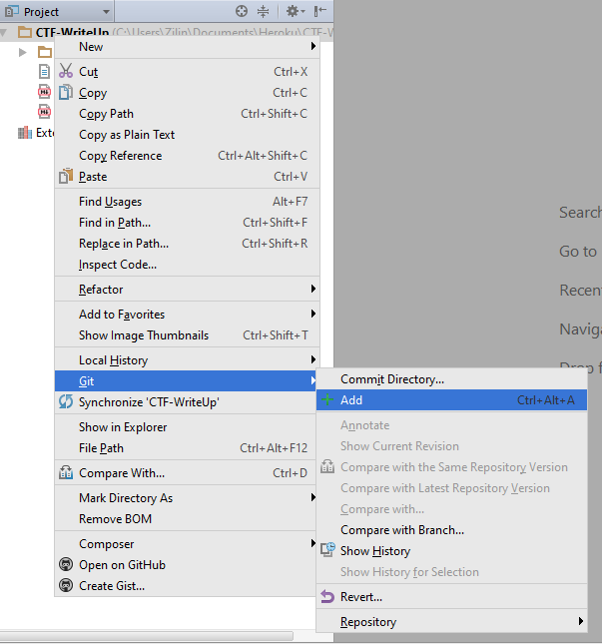
Working with Git in PhpStorm
To update your progress and upload your local changes to GitHub, follow these steps:
Right click on any new files >git > add

Slide 17
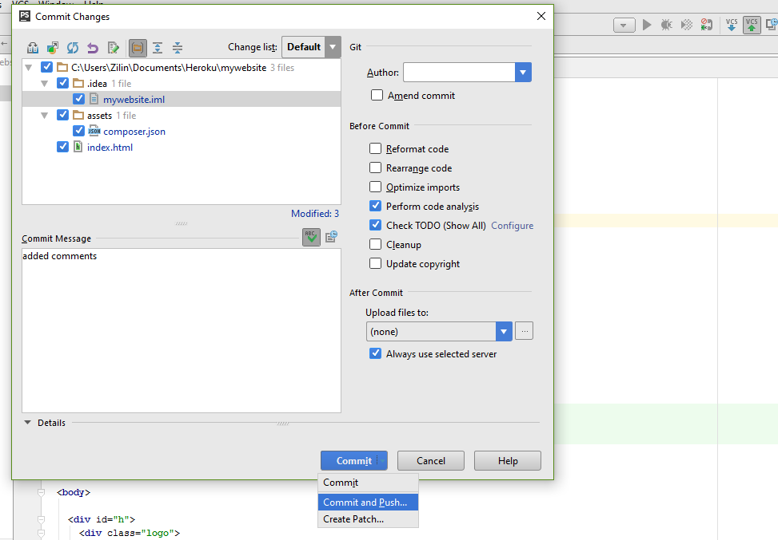
Working with Git in PhpStorm
Click on the VCS up arrow in the top left corner
Add a message detailing what you changed
Click on Commit and Push
Your files should now be
uploaded

Slide 18
Web
A Web Page is consist of Objects.
Objects can be HTML file, JPEG image, Java applet, Video file, Audio file, etc.
Web page is consist of Base HTML-file which includes several referenced objects.
Each object is addressable by a URL.
ex: www.westerncyber.club/somefolder/thisispicture.jpg
Host Name
Path Name

Slide 19
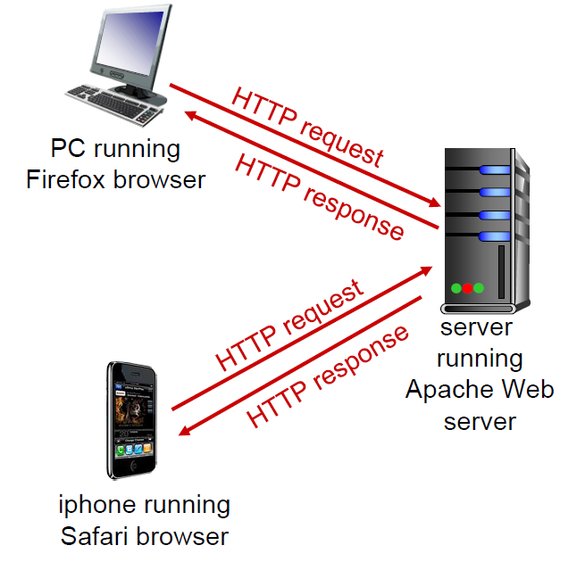
HTTP
HyperText Transfer Protocol is a web’s application layer protocol.
How HTTP calls work
Client sends a request to HTTP server (port 80)
Server response back to client’s IP with objects
Packets
When objects are sent, they are split into small packets
(ex: Torrents (p2p)).
Notes:
-How http calls through port 80
-Clients sends a request to http server through port 80 (port 80 dedicated for web connection)
-Server response back to clients IP with web objects.
Packets
-Web objects are split into small packets, which it makes more efficient since the server does not to remain connected.

Slide 20
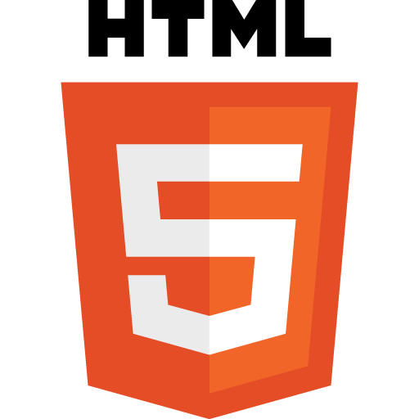

HTML
Hyper Text Markup Language
For creating web pages and web applications.
Unlike scripting or programming languages that uses scripts to perform functions, Markup language uses “Tags” (‘<>’ : angled brackets)
It has “open tag” and the “closed tag”
Ex: <p> </p>
Simple example : A person with no clothes or makeup

Slide 21
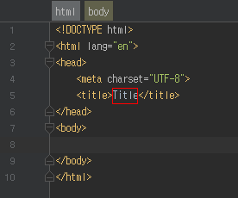
Basic Structure of HTML
<!DOCTYPE html>
Declaration defines this document to be HTML.
<html>
An element that is the root element of an HTML page.
<head>
An element contains meta information about the document.
<body>
An element contains the visible page content.

Slide 22
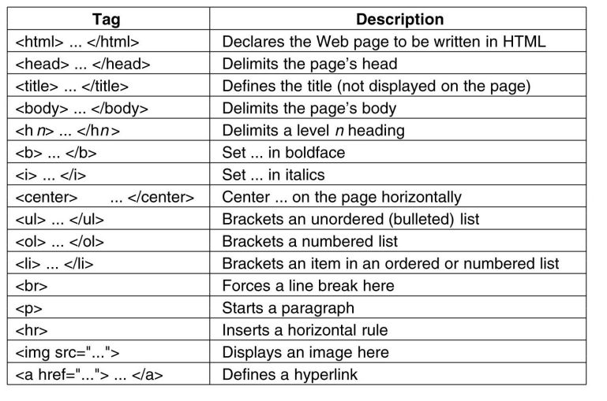
Elements
HTML documents are made up of HTML elements.
It is written using a “Start Tag” and an “End Tag,” and with the “Content” in between.
Elements with no content are called empty elements. Empty elements do not have an end tag. Ex: <br>
(Which indicated a line break).

Slide 23
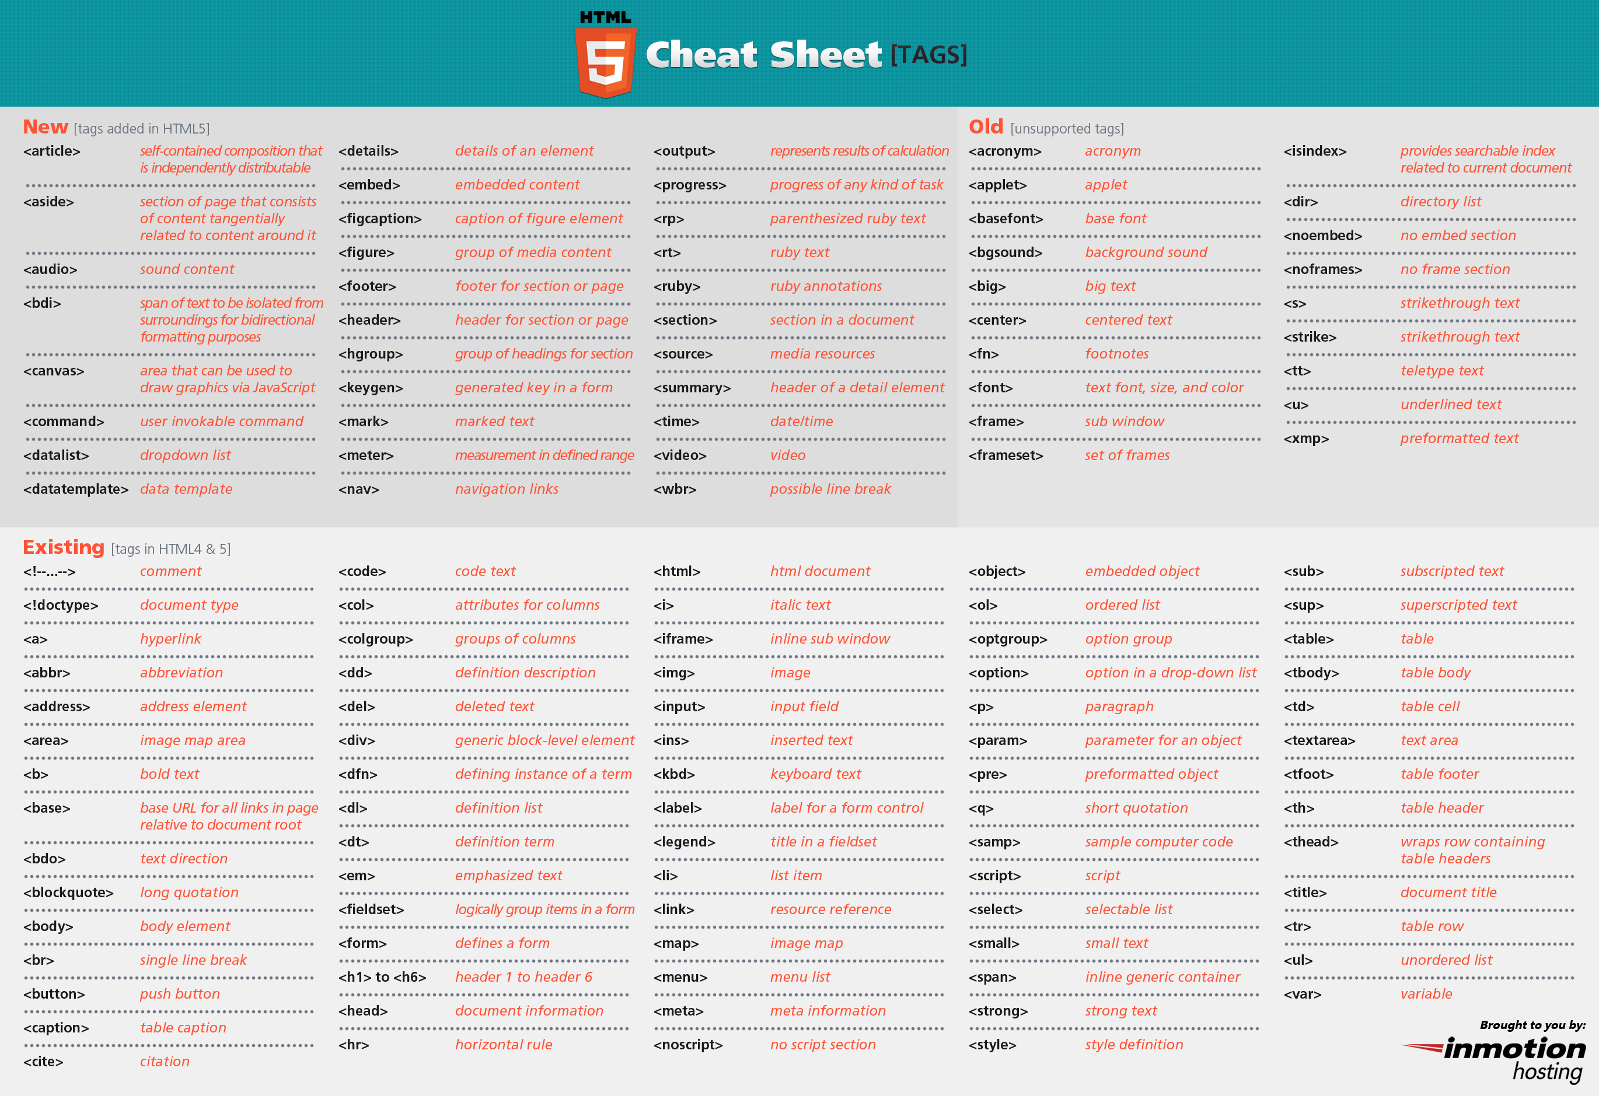

Slide 24
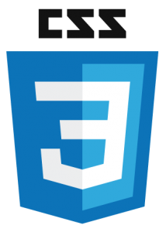
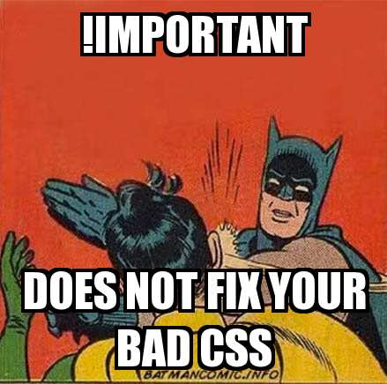
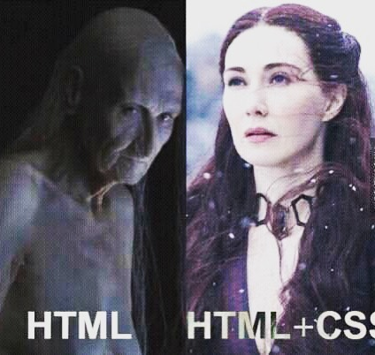
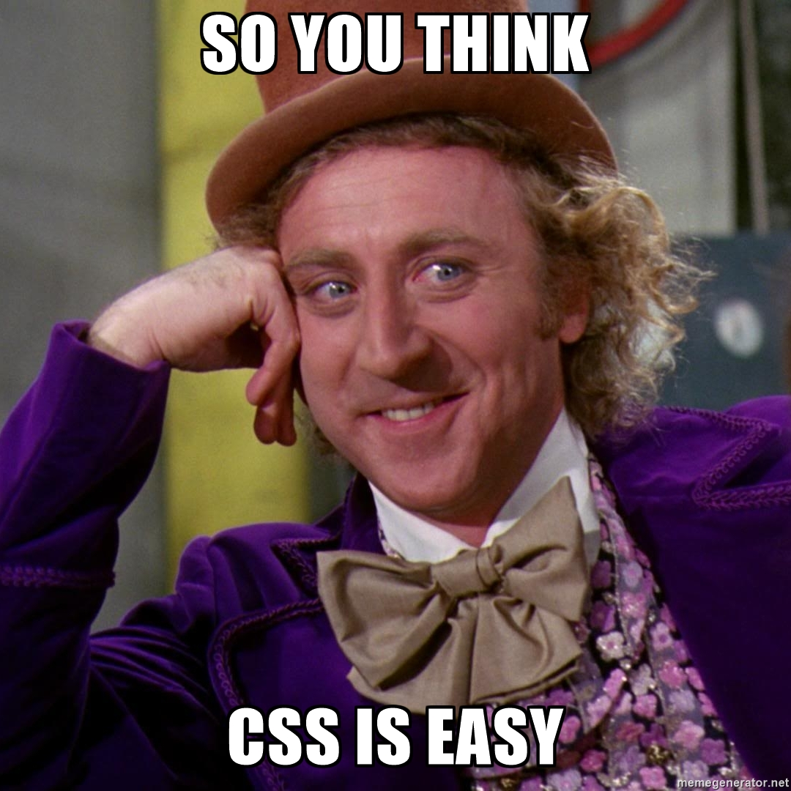
CSS
Cascading Style Sheet
Cascading refers to the way CSS applies one style on top of another.
Style Sheets control the look and feel of web document.
CSS and HTML work hand in hand
HTML: Sorts out the page structure
CSS: Defines how HTML elements are displayed.

Slide 25
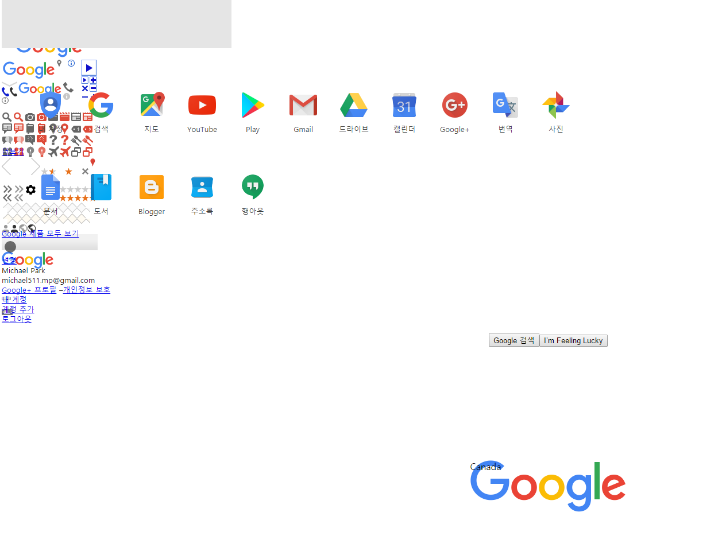
Example: Google.ca

Slide 26
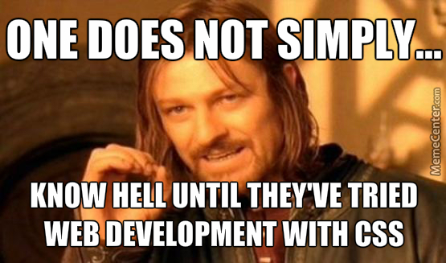
Why Use CSS?
CSS allows you to apply specific styles to specific HTML elements.
The main benefit of CSS is that it allows you to separate style from content.
Using just HTML, all the styles and formatting are in the same place, which becomes rather difficult to maintain as the page grows.
The style definitions are normally saved in external .css files. With an external stylesheet file, you can change the look of an entire website by changing just one file! (as long as its names are consistent).

Slide 27

How CSS works
The selector points to the HTML element you want to style.
The declaration block contains one or more declarations separated by semicolons.
Each declaration includes a CSS property name and a value, separated by a colon.
A CSS declaration always ends with a semicolon, and declaration blocks are surrounded by curly braces.

Slide 28
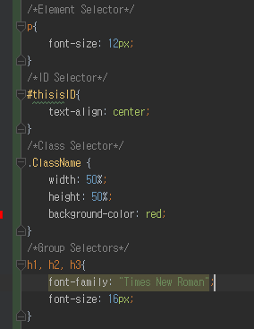
Selector
Element Selector
Name of the element
id Selector
Name of the element
Followed by #
Class Selector
Name of the element
Followed by ‘.’ (period)
Grouping Selectors
Name of the element
Followed by ‘,’ (comma)

Slide 29
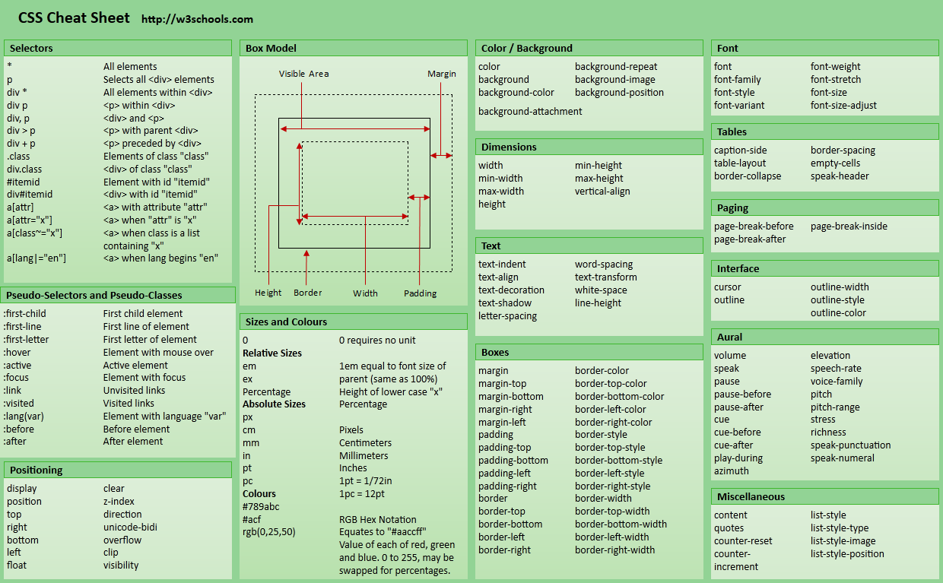

Slide 30
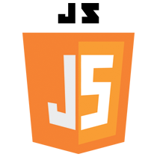
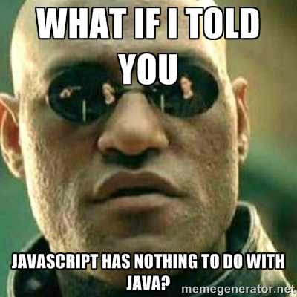
JavaScript
JavaScript is a programming language of HTML and the web.
Alongside HTML and CSS, it is one of the three core technologies of World Wide Web content production; the majority of websites employ it and it is supported by all modern Web Browsers.
Although there are strong outward similarities between JavaScript and Java, including language name, syntax, and respective standard libraries, the two are DISTINCT languages and differ greatly in their design.

Slide 31


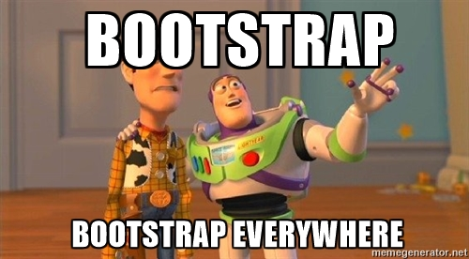
Bootstrap
Bootstrap is the most popular HTML, CSS and JavaScript framework for developing responsive, mobile-first websites.
It is completely free to download and use!
Bootstrap includes HTML and CSS based design templates for typography, forms, buttons, tables, navigation, modals, image carousels and many other!
(plus JS plugins)

Slide 32
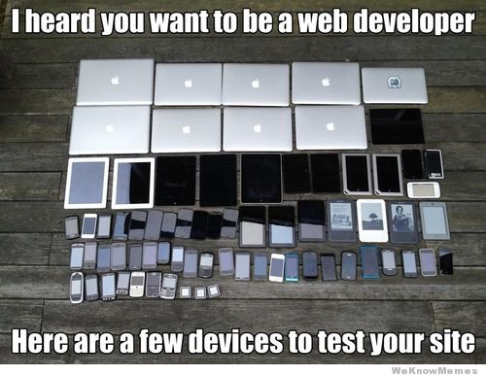
Why do we use it?
Bootstrap is compatible with the latest versions of the Chrome, Firefox, IE, Opera and Safari browsers.
Since version 2.0, it started to support “responsive web design.” This means the layout of web pages adjusts dynamically, taking into account the characteristics of the device used. (Desktop, tablet, Smart phone, etc).

Slide 33
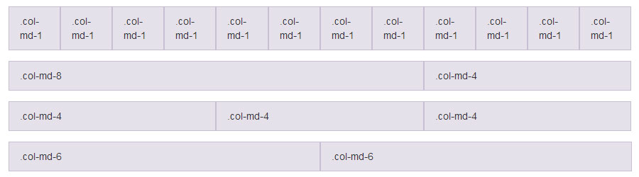
Bootstrap Grids
Row & Col
<div class=“row”>
<div class=“col-__-1~12”>
<div …(contetnts)
xs (for phones)(less than 768px)
sm (for tablets)(768px and up)
md (for desktops)(992px and up))
lg (for larger desktops)(1200px and up)

